Slide 1
Cloud Security and Privacy
Presented By,
Karthika Subramani

Slide 2

Agenda
Overview of Security issues in Cloud Computing
Identity Management
Data Leaks in Cloud Computing
Placement Vulnerability
Differential Privacy in IoT

Slide 3
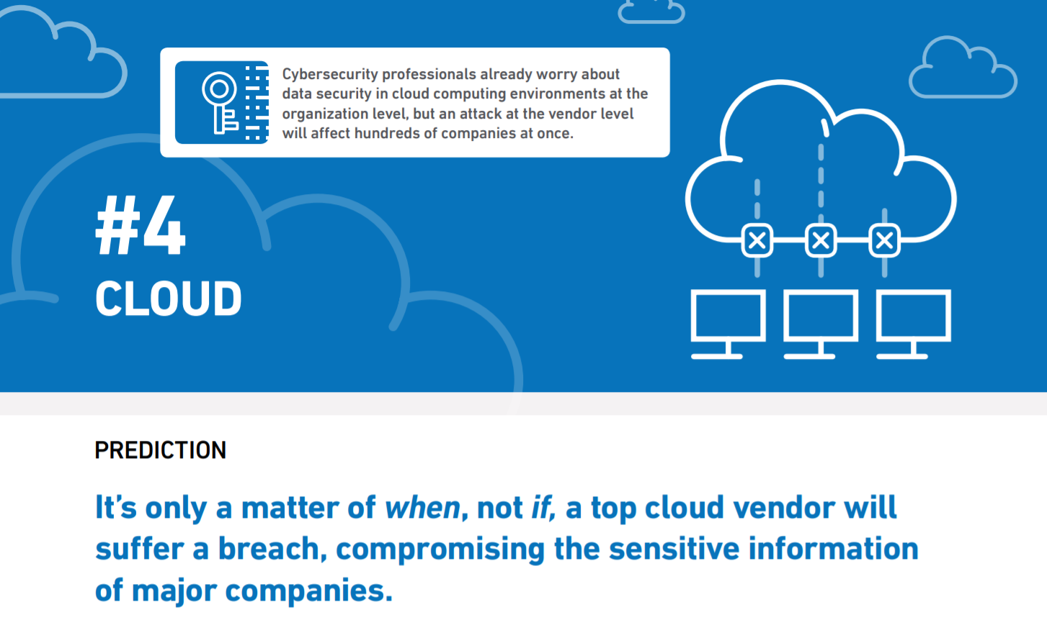
Security Issues
Lack of Trust
Trusting third party cloud providers with sensitive data
Data breaches
Loss of Control
User identity management, user access control and security policies are enforced by cloud providers
Multi-tenancy
Multiple users sharing resources and physical infrastructure
Possibility of attacker being in the same host as a victim

Slide 4
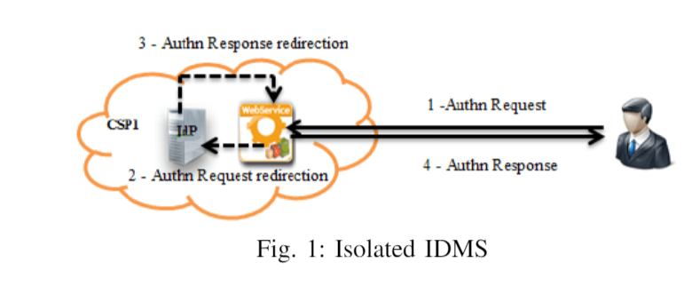
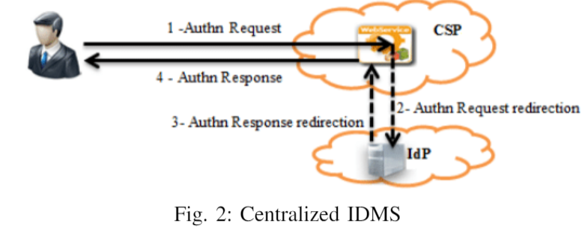
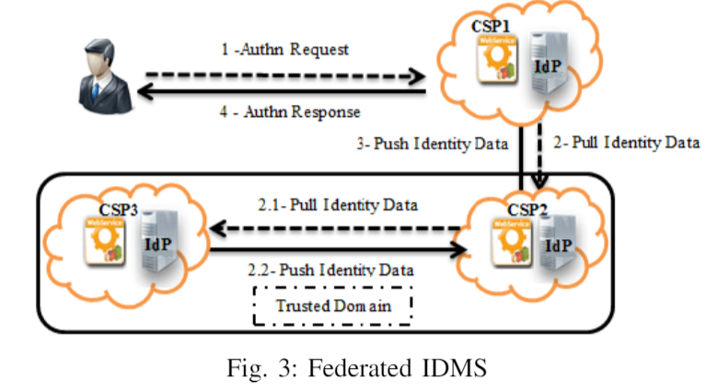
Identity Management
Different models exist for IDM
Isolated IDMS
Centralized IDMS
Federated IDMS
Anonymous IDMS
SAML portable trusted identity
https://www.researchgate.net/publication/262397008_Assessment_Criteria_for_Cloud_Identity_Management_Systems

Slide 5
Active Bundle
An encapsulating mechanism protecting data carried within it
Includes data and metadata used for managing confidentiality
Both privacy of data and privacy of the whole AB
Includes Virtual Machine (VM) performing a set of operations protecting its confidentiality
Active Bundles—Operations
Self-Integrity check
E.g., Uses a hash function
Evaporation/ Filtering
Self-destroys (a part of) AB’s sensitive data when threatened with a disclosure
Apoptosis
Self-destructs AB’s completely

Slide 6
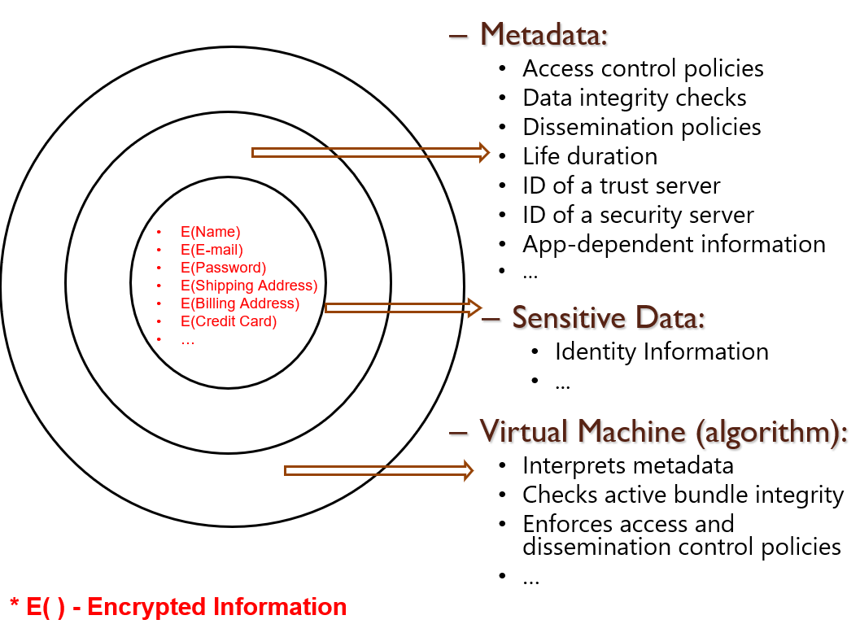
Active Bundle

Slide 7
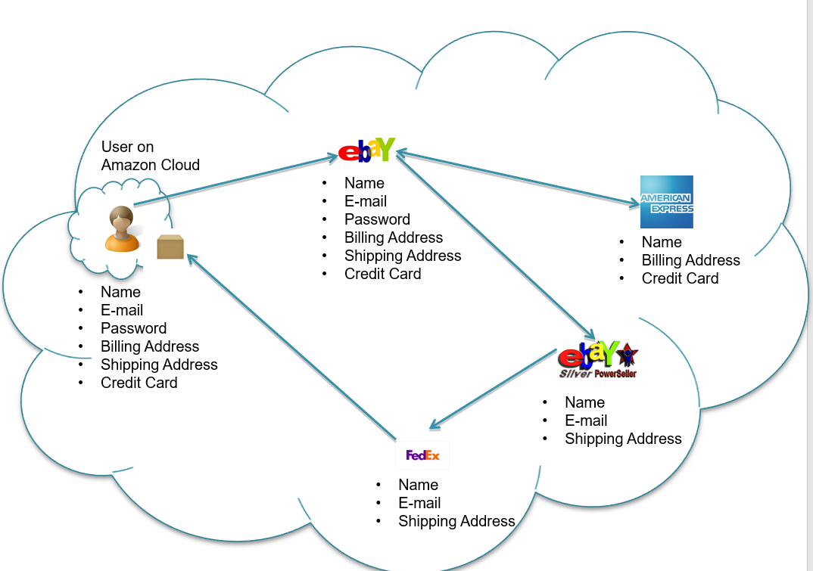
Sample Scenario

Slide 8
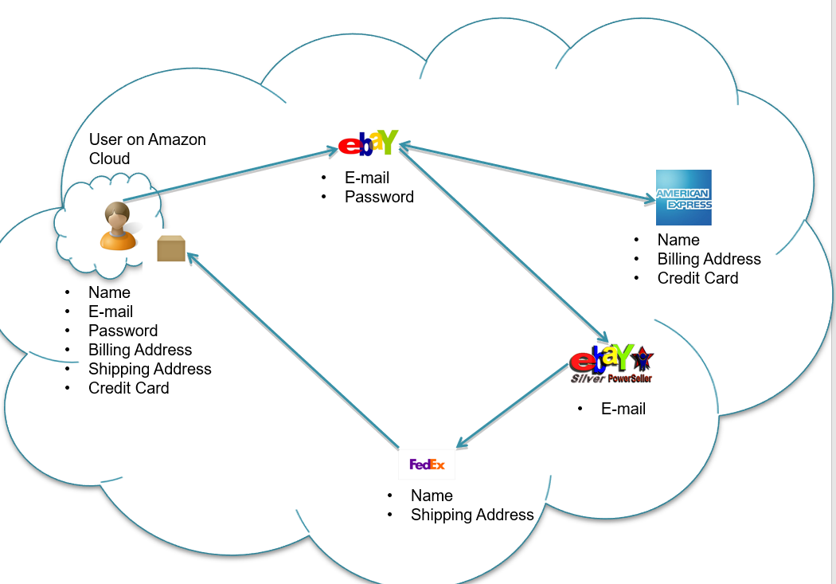
Sample Scenario with Active Bundle

Slide 9
AB: Characteristics & Advantages
Ability to use Identity data on untrusted hosts
Self Integrity Check
Integrity compromised- apoptosis or evaporation
Data should not be on this host
Establishes the trust of users in IDM
Through putting the user in control of who has his data and how is is used
Identity is being used in the process of authentication, negotiation, and data exchange.
Independent of Third Party for Identity Information
Minimizes correlation attacks
Minimal disclosure to the SP
SP receives only necessary information.

Slide 10
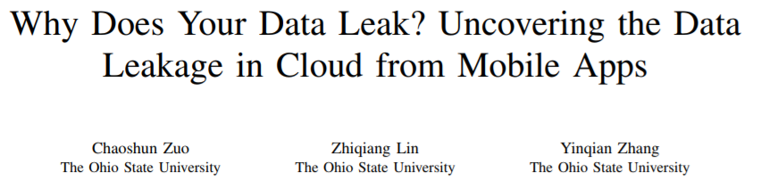
Data Leaks in Cloud Computing

Slide 11
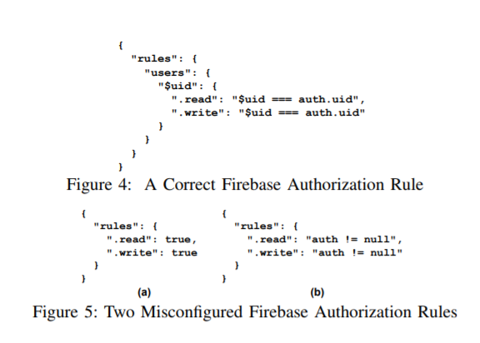
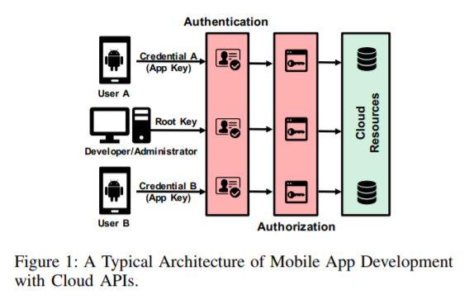
Root Causes for Data Leak
Misuse of Keys
Misconfiguration of user permissions

Slide 12
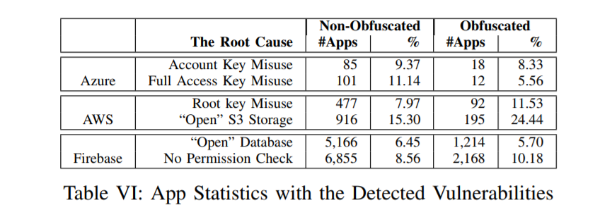
Vulnerabilities Detected

Slide 13
Placement Vulnerability
A Placement Vulnerability Study in Multi-Tenant Public Clouds
Venkatanathan Varadarajan, University of Wisconsin—Madison; Yinqian Zhang, The Ohio State University; Thomas Ristenpart, Cornell Tech; Michael Swift, University of Wisconsin—Madison

Slide 14
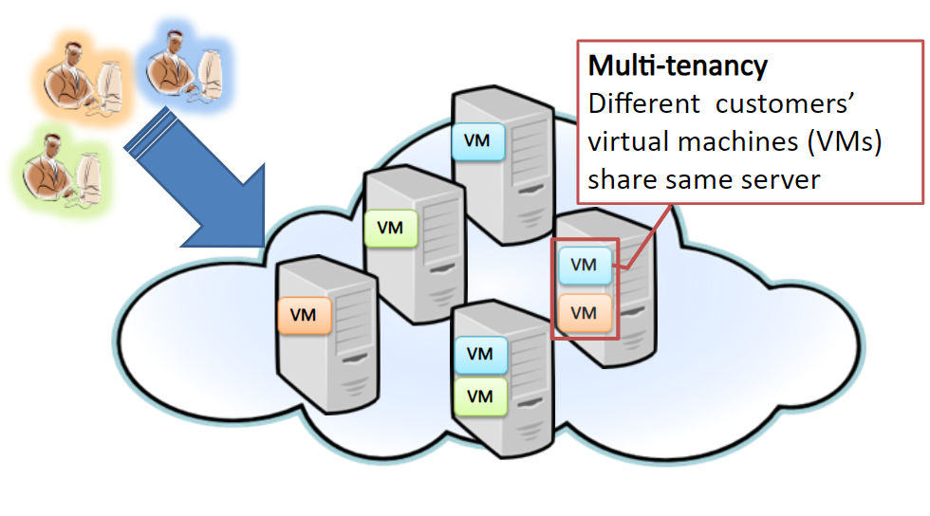
Multi-Tenancy

Slide 15
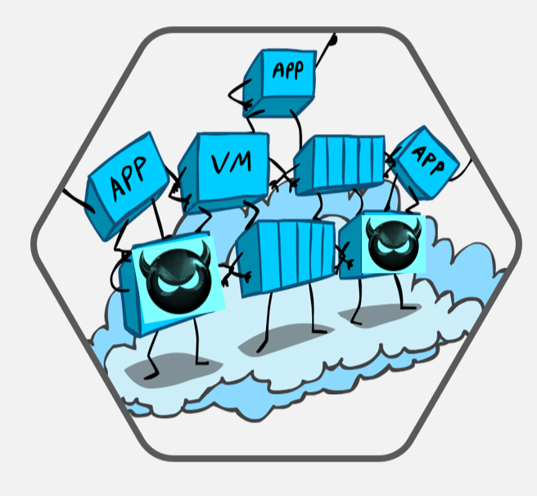
Threats & Attacks
Attacker launching a VM on the same host as target VM
Side-channel attacks
Monitor Resource Usage
Steal Encryption keys
Placement vulnerability
Can an attacker place a VM on the same host as target?
Identify vulnerability in 3 major providers
Amazon EC2
Google Compute Engine(GCE)
Microsoft Azure
Co-Residency Detection
How surely can we detect that attacker VM has been placed in the same host as target VM?
Can we quantify the time and cost for an adversary to achieve a certain probability of success?

Slide 16
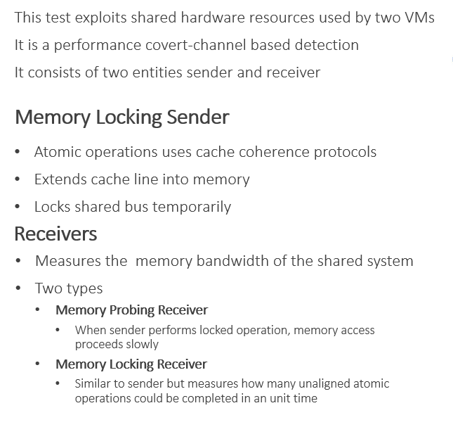
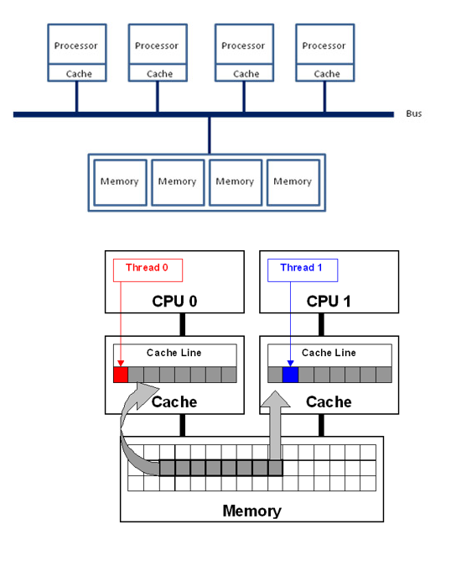
Co-Residency Tests

Slide 17
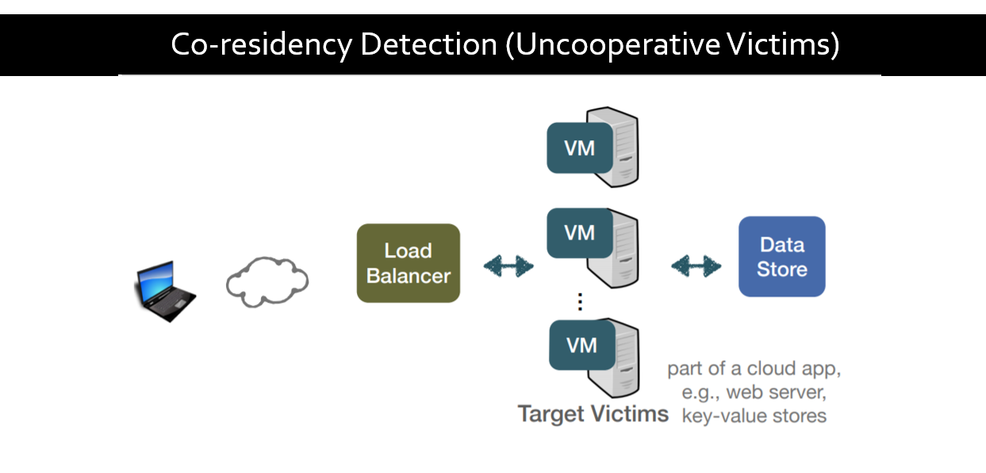

Slide 18
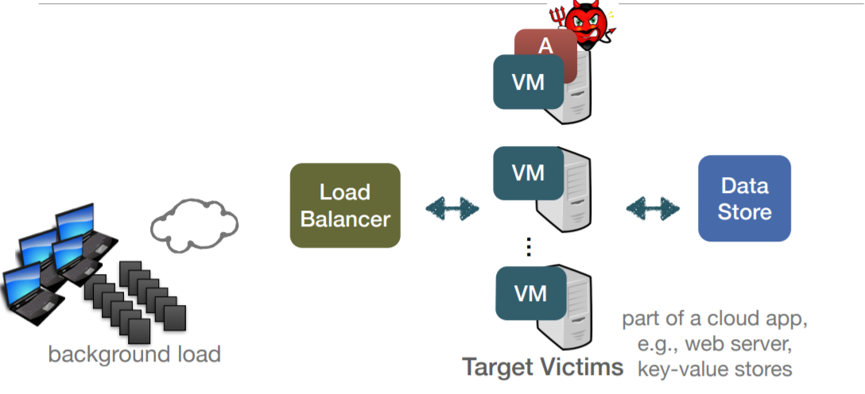
Co-residency Detection (Uncooperative Victims)

Slide 19

Co-residency Detection (Uncooperative Victims)

Slide 20
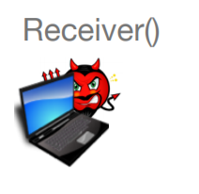
Co-residency Detection (Uncooperative Victims)

Slide 21
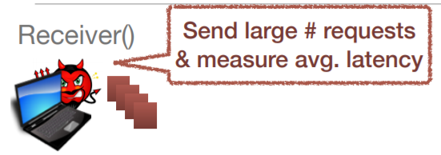
Co-residency Detection (Uncooperative Victims)

Slide 22
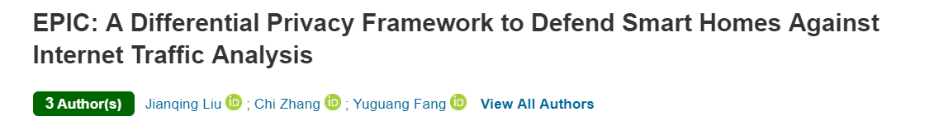
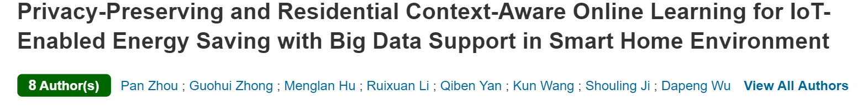
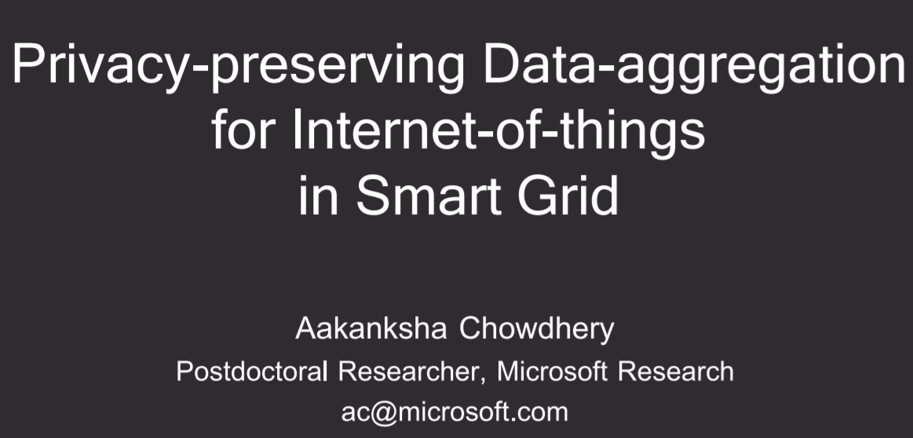
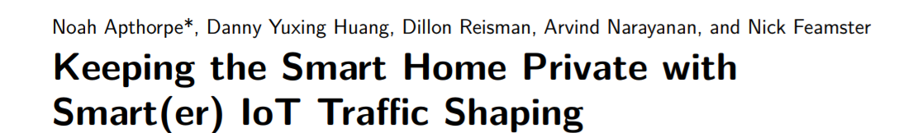
Differential privacy in IoT

Slide 23
Thank You!! ☺

